Slide 1

AMCAT ANALYSIS

Slide 2
Agenda
Introduction
Objective of the Project
Dataset Description
Data Preprocessing
Exploratory Data Analysis:
Univariate Analysis
Bivariate Analysis
Multivariate Analysis
Research Question and findings
Conclusion (Key finding overall)

Slide 3
Introduction
This project involves the analysis of a dataset containing student and job-related information, including demographics, education details, salary, job roles, and personality traits. The main aim of the analysis is to explore relationships between various factors like salary, specialization, and gender, as well as assess the impact of personality traits on salary outcomes. We performed Exploratory Data Analysis (EDA) to uncover insights and applied statistical testing to validate claims and assumptions about salary distribution and role-specific averages

Slide 4
Objective of the Project
To explore and determine key factors that influence student salary outcomes, specifically analyzing relationships between job roles, education background, gender, and personality traits.

Slide 5
Dataset Description
The dataset was released by Aspiring Minds from the Aspiring Mind Employment Outcome 2015 (AMEO). The study is primarily limited only to students with engineering disciplines. The dataset contains the employment outcomes of engineering graduates as dependent variables (Salary, Job Titles, and Job Locations) along with the standardized scores from three different areas – cognitive skills, technical skills and personality skills.The dataset also contains demographic features. The dataset contains around 40 independent variables and 4000 data points. The independent variables are both continuous and categorical in nature. The dataset contains a unique identifier for each candidate.

Slide 6
Data Preprocessing
Checked for missing values
Handled Duplicates
Outlier Detection in numerical Columns using Interquartile Range Method.

Slide 7
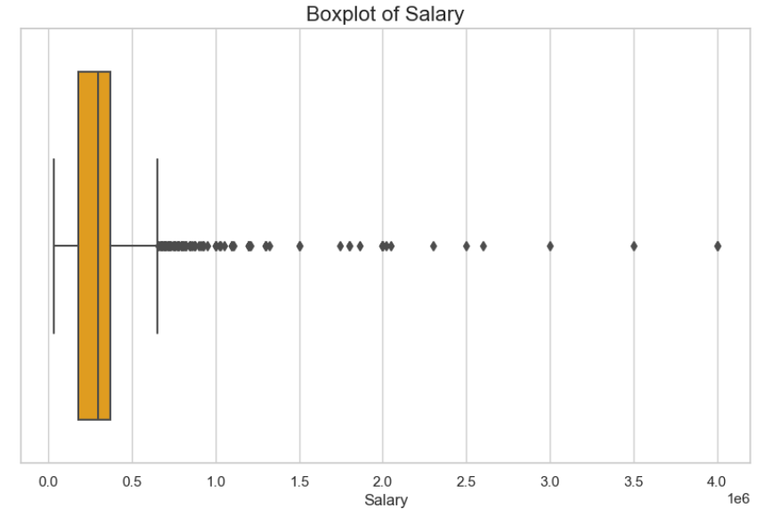
Exploratory Data Analysis
Univariate Analysis
Distribution of Salary
The IQR, which represents the spread of the
middle 50% of the data, is relatively small.
This indicates that a majority of the salaries are
clustered around the median.There are several
outliers, indicated by the individual dots.
These are salaries that are significantly higher or
lower than the majority of the data.

Slide 8
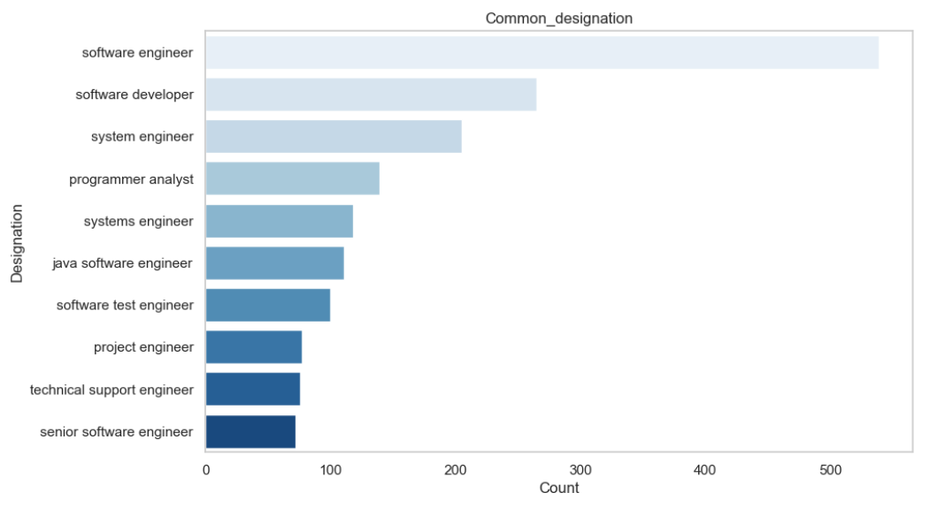
The most common job location for students is Bangalore, followed by Noida and then Hyderabad.
Common Designation/Job Role:
Most of the students are working as
Software Engineers. The plot here depicts
the top 10 Job Role among the students

Slide 9
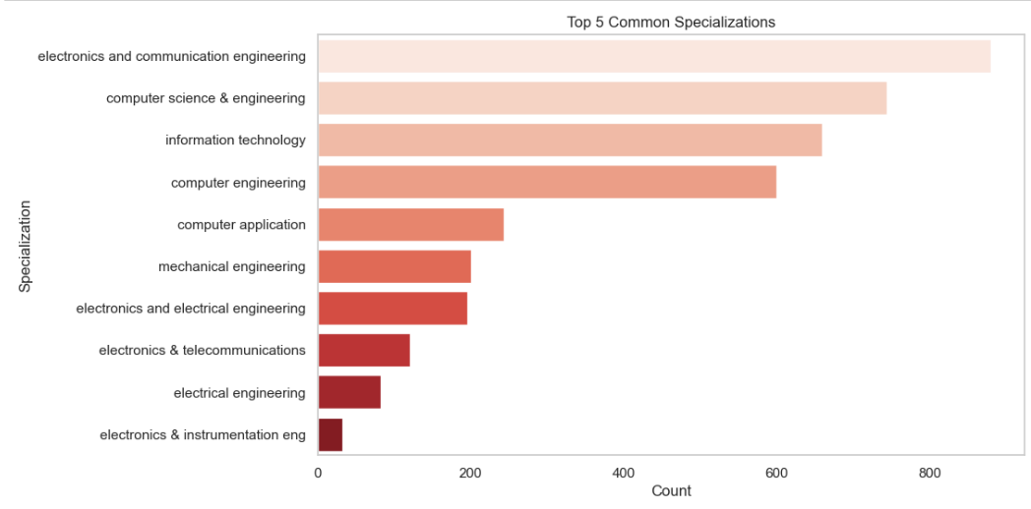
Common Specialization among Students:
Electronics and Communication Engineerings is
the most common specialization
among students. This plot depicts the top 10
specializations among students.
Most students completed their 10th and 12th grades under the CBSE board, and the
majority earned a B.Tech/B.E degree.

Slide 10
b. Bivariate Analysis
Analysis of designations with more salary
The highest salary designation is Junior Manager, with an average salary of ₹1,300,000.
The Senior Developer designation follows closely, offering an average salary of ₹1,110,000.
Data Scientists earn an average salary of ₹896,667, ranking them among the top earners.
Other notable designations include Field Engineer (₹801,667) and Assistant Manager (₹800,000).
Analysis of average College GPA among high-salaried roles
An analysis of average college GPA among high-salaried roles reveals that Electrical Design Engineers have the highest average GPA of 88.60.
Game Developers and Engineering Managers also exhibit high GPAs of 87.10 and 86.10, respectively.

Slide 11
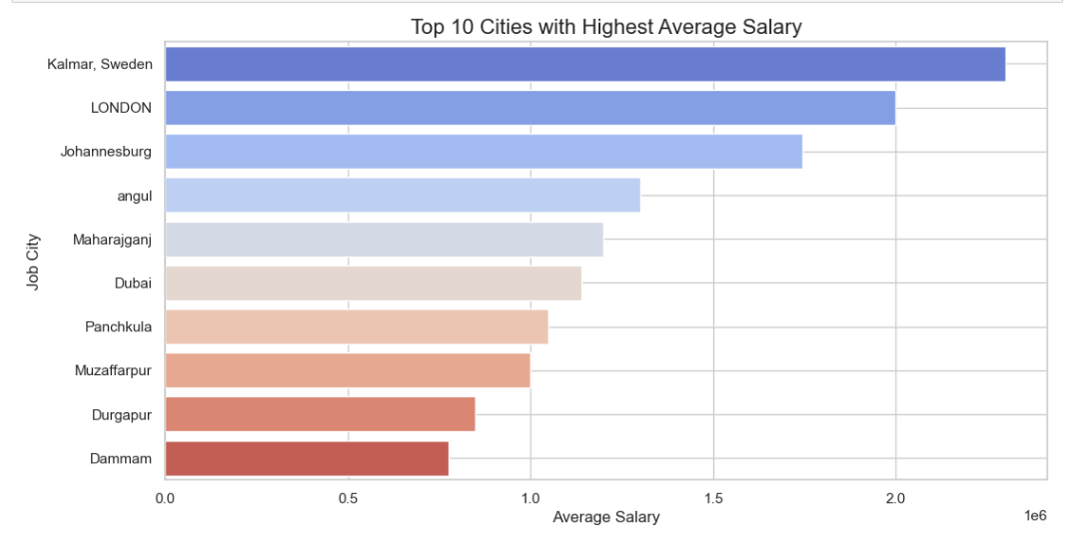
Analysis of Salary Variation in Job Locations
The cities with the highest average salaries were identified, indicating significant geographical salary variations.
Analysis on how specialization influencing salary
Specializations such as Polymer Technology and Computer Networking are associated with higher average salaries of ₹700,000 and ₹565,000, respectively.
Information Science and Instrumentation and Control Engineering specializations also show strong average salaries of ₹460,000 and ₹394,000.

Slide 12
Analysis of Degree and Designation
For B.Tech/B.E. graduates, the leading designations are Software Engineer with 502 positions and Software Developer with 226 positions.
In the case of M.Sc. (Tech.) graduates, both Programmer and Software Engineer have 1 position each.
Among M.Tech./M.E. graduates, the top designations are Software Engineer with 7 positions and Assistant Professor with 4 positions.
For MCA graduates, the most common designations are Software Developer with 38 positions and Software Engineer with 29 positions

Slide 13
C. Multivariate Analysis
Correlation between Personality Traits and Salary
Conscientiousness shows a strong positive correlation with salary, indicating higher salaries for more conscientious individuals.
Agreeableness and extraversion exhibit positive correlations with salary, though weaker than conscientiousness.
Neuroticism has a negative correlation with salary, suggesting that more neurotic individuals tend to earn lower salaries.
Openness to experience does not demonstrate a significant correlation with salary.
Relationship between Total AMCAT Score and Salary
A weak positive correlation of 0.25 is observed between AMCAT Total Score and salary.
As the AMCAT Total Score increases, there is a slight tendency for salary to increase, but the relationship is not strong.
Significant variation in salary exists for a given AMCAT Total Score, indicating other influencing factors.
The presence of outliers in the higher salary range may affect the correlation.

Slide 14
Research Question and Findings
Research Question 1: Times of India article (dated Jan 18, 2019) states: “After doing your Computer Science Engineering if you take up jobs as a Programming Analyst, Software Engineer, Hardware Engineer, or Associate Engineer, you can earn up to 2.5-3 lakhs as a fresh graduate.”
The average salary for specific roles after completing Computer Science Engineering was found to be significantly different from ₹275,000.
T-statistic: 5.99
P-value: 9.89e-09
Research Question 2: Preference of Specialization and Gender
The preference of specialization is dependent on gender.
Chi-Square Statistic: 104.47
P-value: 1.25e-06
Research Question 3: Relationship between Gender and Salary
There is a significant difference in salary based on gender.
T-statistic: 2.13
P-value: 0.033

Slide 15
Conclusion
The analysis conducted on the dataset reveals several significant insights regarding the factors influencing salary among students.
Personality Traits: A strong positive correlation was observed between salary and the personality trait of conscientiousness, suggesting that individuals with higher conscientiousness tend to earn more. Agreeableness and extraversion also showed positive correlations, albeit weaker, while neuroticism had a negative correlation with salary.
AMCAT Total Score: There exists a weak positive correlation (0.25) between the AMCAT Total Score and salary, indicating that higher AMCAT scores are associated with higher salaries. However, the scatter plot reveals considerable variation in salaries at similar score levels, implying that additional factors affect salary outcomes.
Statistical Testing on Salaries:
The t-test for fresh graduates in roles such as Programming Analyst and Software Engineer indicated that the average salary is significantly different from the claimed ₹275,000, rejecting the null hypothesis.
The Chi-Square test demonstrated that the preference for specialization is influenced by gender, suggesting non-independence between these variables.
An independent t-test revealed a significant difference in average salaries between males and females, with the analysis supporting the rejection of the null hypothesis.

Slide 16

THANK YOU

